Slide 1

DEPARTMENT OF ELECTRONICS AND COMMUNICATION ENGINEERING
FIRST REVIEW
HYBRID BIN
BATCH NUMBER : NSNCET/18-19/EC-PRJ/09
BATCH MEMBERS: GURUSIVARAM.K (920915106018)
MANI.K (9209151060)
LOGANATHAN.P (9209151060)
PROJECT SUPERVISOR: Mr. RENUKA.G , AP/ECE ‘A’

Slide 2
ABSTRACT
The total concept is about the segregation of solid wastes into two types with the help of sensors.
This process is done with the help of several factors like inductivity, moisture of the wastes.
When the waste is thrown into the bin the bin checks for the type of wastes and after that it will segregate the waste.
Then the user is also notified if the bin is running out of storage via SMS and also in an LCD display.

Slide 3
INTRODUCTION
The main problem is modern India is managing the solid wastes in both rural and urban areas.
There are other previously used techniques like spectroscopy method, buoyancy method etc. are very complex process.
So the main aim of this Hybrid Bin is the segregate wastes at very low cost and low power and completely autonomous.
Using the ultrasonic sensor, inductive proximity sensor and moisture sensor, we can easily conclude the type of wastes for the further process.
The segregator plate with the help of stepper motor rotates in both directions to segregate the wastes into degradable and non-degradable wastes.
Then user is also get notifications via mobile if the Bin is full using GSM module.

Slide 4
LITERATURE SURVEY
AUTHOR NAME | TITLE | YEAR | CONCEPT AND DRAWBACK
M.K.pushpa Stuti jha v | Microcontroller based automatic waste segregator | 2018 | Developing mechanized system to help save the lives of many and making the world cleaner and a greener place is the noble objective of our project.

Slide 5
Contd…,
AUTHOR NAME | TITLE | YEAR | CONCEPT AND DRAWBACK
S.S.Navghane M.S.Killedar Dr.V.M.Rohokale | IoT Based Smart Garbage and Waste Collection Bin | 2018 | These dustbins are interfaced with microcontroller based system having IR wireless systems along with central system showing current status of garbage on mobile web browser with html page by Wi-Fi.

Slide 6
Contd…,
AUTHOR NAME | TITLE | YEAR | CONCEPT AND DRAWBACK
Ashima Bajaj Sumanth Reddy | Garbage Monitoring System Using IOT | 2018 | By using garbage monitoring system the information of all smart dustbins can be accessed from anywhere and anytime by the concern person and he/she can take the decision accordingly.

Slide 7
Contd…,
AUTHOR NAME | TITLE | YEAR | CONCEPT AND DRAWBACK
Prof. Dr. Sandeep M. Chaware Shriram Dighe | Smart Garbage Monitoring System using Internet of Things (IOT) | 2018 | In solid waste bin monitoring system garbage bin set the public place then Camera set for garbage bin location. The camera captured image for garbage bin.

Slide 8
Contd…,
AUTHOR NAME | TITLE | YEAR | CONCEPT AND DRAWBACK
Shadakshari R. | Waste segregation using smart dustbin | 2017 | The main of the Description is to segregate waste at source level to wet, dry and metallic such that waste is not wasted but there value is understood and can be converted to a source of energy, in a cost of effective way.

Slide 9
Contd…,
AUTHOR NAME | TITLE | YEAR | CONCEPT AND DRAWBACK
Kavya M Sahana P | Sensor based smart dustbin for waste segregation and status alert | 2017 | The generation and disposal of waste in large quantities has created greater concern over time for the world which is adversely affecting the human lives and environmental conditions. Segregation of waste is important for proper disposal of vast amount of garbage modern society produce in an environmentally sensible mode.

Slide 10
Contd…,
AUTHOR NAME | TITLE | YEAR | CONCEPT AND DRAWBACK
Dr.baswara Syeda madiha PallavI B.V | Automatic waste metal, glass and plastic waste sorter | 2017 | This method is injurious to human health, plant and animal life. This harmful method of waste disposal can generate liquid leachata which contaminate surface and ground waters. When the waste is segregated into basic streams such as wet, dry and metallic, the waste has a higher potential of recovery and consequently recycled and reused.

Slide 11
Contd…,
AUTHOR NAME | TITLE | YEAR | CONCEPT AND DRAWBACK
Fetulhak Abdurahman Sileshi Aweke | Automated Garbage Monitoring System Using Arduino | 2017 | In this paper they used the camera to monitor the waste in real time.

Slide 12
Contd…,
AUTHOR NAME | TITLE | YEAR | CONCEPT AND DRAWBACK
Ms. Rupa Ms. Rajni Kumari, Ms. Nisha Bhagchandani | Smart Garbage Management System Using Internet of Things (IOT) For Urban Areas | 2017 | In this paper we are going to propose a smart garbage management system based on IOT for urban areas acts as one of the innovative system to keep the cities clean.

Slide 13
Contd…,
AUTHOR NAME | TITLE | YEAR | CONCEPT AND DRAWBACK
Janaki.S Nanthini.N Yamini.S | Internet of Things (IoT) Based Smart Garbage Monitoring and Clearance System | 2017 | The system will get input through the concerned person through switches and send signal to the Microcontroller unit using RF technology and that makes the H-bridge to rotate conveyor belt.

Slide 14
Contd…,
AUTHOR NAME | TITLE | YEAR | CONCEPT AND DRAWBACK
Alana V.J Kavya Balakrishnan Rosmi T.B | Automatic waste segregator and monitoring system | 2016 | This paper proposes an automatic waste segregator which is has a cheap, easy to use the solution for a segregation system at house holds, so that the waste can be send directly for processing.

Slide 15
Contd…,
AUTHOR NAME | TITLE | YEAR | CONCEPT AND DRAWBACK
G.Krishna veni B.Uma | Automatic waste(metal and non metal)separation using IR sensor | 2016 | The main theme of the project is to segregate waste because when the waste is separated into stream such as wet, dry and metallic.

Slide 16
Contd…,
AUTHOR NAME | TITLE | YEAR | CONCEPT AND DRAWBACK
Narayanan sharma Tanmoy dutta | Smart Bin Implementation for Smart Cities | 2016 | Few decades there is a rapid growth in the rate of urbanization and thus there is a need of sustainable urban development plans.

Slide 17
Contd…,
AUTHOR NAME | TITLE | YEAR | CONCEPT AND DRAWBACK
Archana babu s Arunima Bhana chandran | An Economic Automatic waste Segregator using Arduino | 2016 | The main goal of this paper is to design and develop a segregation system witch sort wastes automatically in to wet, dry or metallic using arduino.

Slide 18
EXISTING METHOD
In industries like plastic manufacturing, uses buoyancy method to segregate the plastic wastes from other wastes.
Some other companies uses spectroscopy method to identify the plastic waste by projecting ray of light beam and they measure the reflected beam to find the plastics.
All the methods include heavy machineries and they have motors, conveyor belts, huge tanks and they need high power source, human to control them.
Those methods are very costly and larger in size that cannot be implemented in homes.

Slide 19
PROBLEM TO BE SOLVED
They must not contain any harmful chemicals and machines.
The power consumption must be reduced.
It cost and size of the device should be tiny as possible to fit in homes.
They must be completely autonomous, efficient and user friendly.
It should not use any complex methods for segregation process.

Slide 20
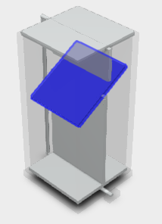
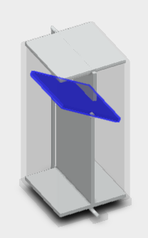
PROPOSED METHODOLOGY
The segregator plate will be driven by stepper motors.
This rotates the separator plate up to 60 degree in both sides.
For recyclable, it rotates towards anticlockwise direction.
For degradable wastes, it rotates towards clockwise direction.

Slide 21
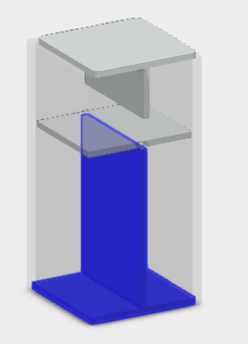
Contd…,
After the proper separation, the wastes will be stored in their respective chambers for disposal.
The bottom door can be opened easily for separated disposal.

Slide 22
Contd…,
ULTRASONIC SENSOR
MOISTURE SENSOR
INDUCTIVE PROXIMITY SENSOR
GSM SIM900A
MODULE
MSP430
MICRO CONTROLLER
STEPPER DRIVER
L298N H
POWER SUPPLY
12V/2A
LCD DISPLAY MODULE
STEPPER MOTOR

Slide 23

Contd…,
This exploded view will give the brief view of the Bin structure both internally and externally

Slide 24
FLOW CHART
Plastic wastes
Metal wastes
Food wastes
HYBRID BIN

Slide 25
Contd…,
Presence of waste
Food waste
Degradable side
Metal waste
Non-degradable side
Non-degradable side
Plastic waste

Slide 26
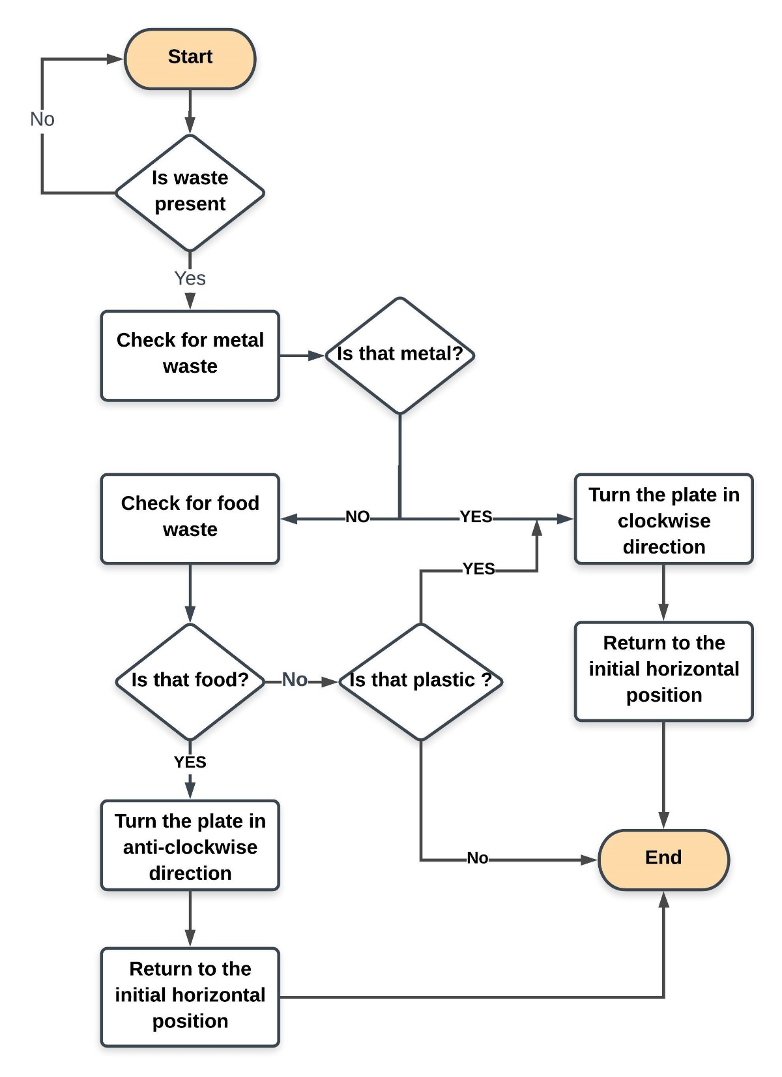
Contd…,

Slide 27
EXPECTED OUTCOME
The plastic and metal wastes are segregated and goes into non-degradable side of the bin.
The food wastes goes into the degradable side of the bin.
If the bin is full, the user will get notified in mobile and LCD display attached with the bin.

Slide 28
WORK DONE
The Embedded coding for the bin has been completed.
The Embedded components required for the bin are gathered.
The structure of the is has been modeled in 3D for better understanding.
The main structure prototype has been modeled in plywood and the work is in progress.

Slide 29
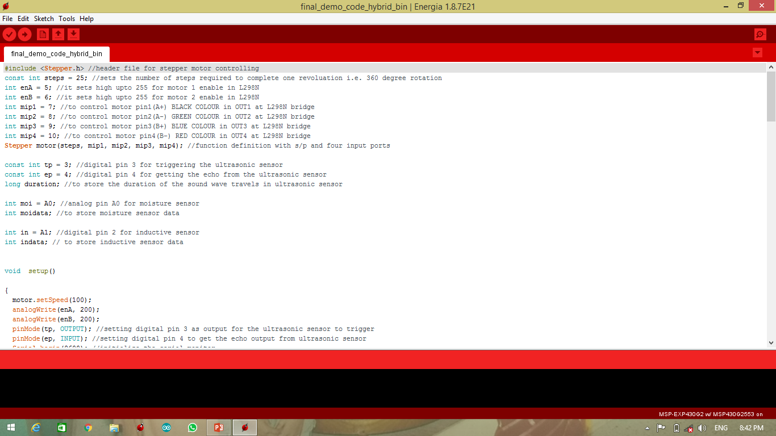
Contd…,

Slide 30
ADVANTAGES
The cost of the bin is very affordable.
The size is very similar to conventional dust bin.
The segregation mechanism is very simple.
It is completely autonomous and user friendly.
The user will also get notification in their mobile in the case if the bin is full of its capacity.
The bin is completely made out of wood. Hence it is environment friendly too.

Slide 31
THANK YOU

